Slide 1
TDG – Architectural Flow

Slide 2




TDG – ARCHITECTURAL FLOW
Start
Process the Dictionary information to generate UI screen
SEQUENCE OF ACTIVITIES:
A Database Dictionary is uploaded into the Engine.
The engine validates the metadata pattern in the dictionary against the Non prod dB Meta data.
Upon successful validation, an entry is made into TDG database.
The data from dictionary is then gathered to produce a logical Search screen (GUI)
A user would give the inputs using the GUI.
Logical search again hits the Engine which would make an appropriate entry into the relevant columns of the non prod dB.
An entry would also be made into the TDG database for tracking & reporting purposes.
Upload Dictionary
4
1
Non Prod databases
GUI
Validate Dict.
2
5
Yes
6
Validation Success
TDG Engine
No
Processes data onto respective databases
3
Reassess the Dictionary Format
TDG dB
4
Get Data from TDG
ENGINE INTELLIGENCE:
** The engine generates default Unique values in the fields, if the field definition is (Not null) – Especially where field entry is essential & not selected in Input criteria.
** Gets all the relevant tables from the dB & arranges them in a sequence for data input based on the relationships defined in the dictionary.
** Generates Primary keys from the dictionary defined values or else considers Max+1 value from the dB tables.
An entry also goes to TDG Database
7

Slide 3
Differentiators
With highly efficient Data generation mechanism embedded into the Utility, the Test Data Generator can significantly reduced the efforts invested in synthetic data manufacturing.
Quicker turn around
With highly robust logic of data generation from referential integrity perspective, TDG ensures a data of top quality, which mocks the live like content to cater “fit for purpose” test data.
Higher quality
Reduced Infrastructure
With understanding of test data requirements in advance to customize the essential data dictionaries, TDG gives the leverage to eliminate the production copies, ETLs involved alongside addressing the test data needs effectively.
TDG with its rich live like data set generation capability, eliminates the need of production data in most of the scenarios. This would minimize the risk of live data exposure thus enforcing a “live data exception model”
Data Security
Cost effective & higher savings
With a quicker understanding of data requirements, an unambiguous data provisioning strategy can be designed for a quicker data generation using TDG. This can expedite the time taken for the product to “go to market”

Slide 4
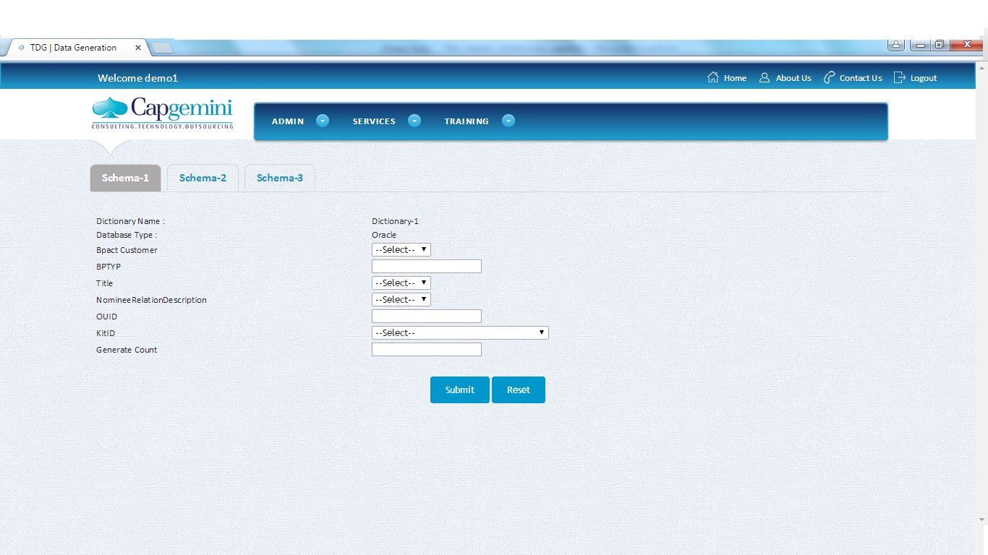
TDG Prototype

Slide 5
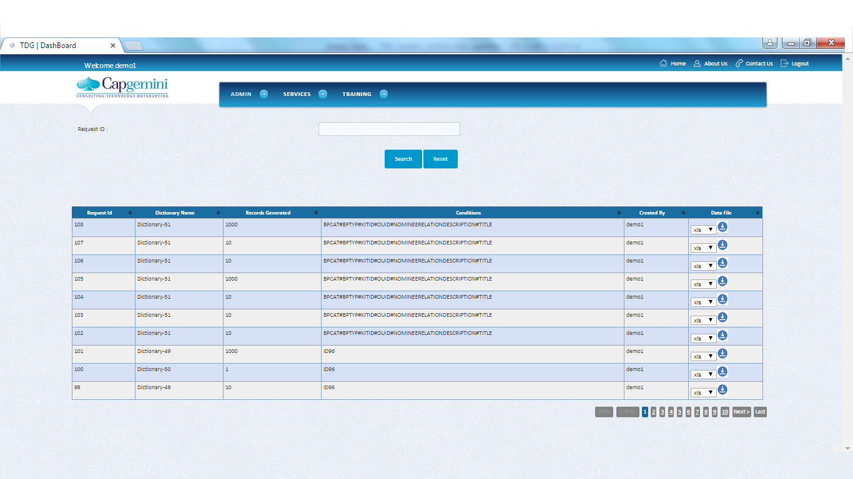
TDG Prototype

